Slide 1
Viability of Recycled Plastics in Asphalt and Sprayed Sealing
Christina Chin
Principal Consultant
12 March 2020

Slide 2
Project Objectives
Background
Using recycled materials on our roads
Case studies
Benefits
Areas of concerns
Governance
Recommendations

Slide 3
1. Project Objectives
Provide Australia and New Zealand road authorities with a better understanding of the viability of using recycled plastics in asphalt and sprayed sealing
Provide guidance on future R&D priorities
Conducted a local and international literature review discussing the benefits and challenges of using recycled plastics in road pavements

Slide 4
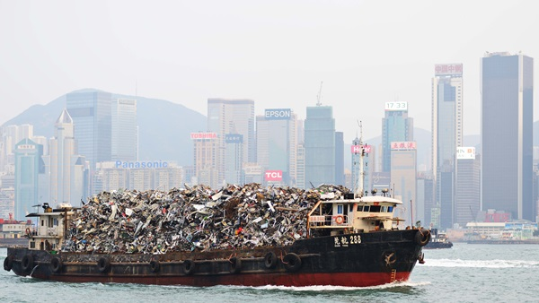
2. Background
2016 -2017, AU exported 1.2 million tonnes of waste to China
1 Jan 2018, enforcement of China National Sword Policy
1 Mar 2019, India announced complete ban of plastic waste import
How did AU respond ?
Notes:
Australia export a substantial amount of waste overseas. Mainly to China and India.
Estimated Au exported 1.2 mil tonnes of waste to china in 2016-2017
However, on 1 Jan 2018, the enforcement of China National Sword Policy has restricted the importation of 24 categories of solid waste into China and limited the contaminations of these materials to less than 0.5%.

Slide 5
Australia’s response
Notes:
There was a collaborative approach across AU in responding to this immediate problem.
Most of the state government has pledged to support local government, councils and the industry financially
EPA has temporarily allowed an increase in stockpiling limits
While these are very good approaches to manage the epidemic, it is not sustainable
The amount of waste disposal is not reducing. If not, it is increasing.
With so much of waste being generated and going to landfill, recycling becomes a major sustainability issue
Therefore, there is a growing interest in using recycled plastics … in this context, using recycled plastics on our roads.
As modifiers in hot mix asphalt as a sustainable and cost effective pavement solution method.

Slide 6
3. Recycled Materials on Our Roads
What is the purpose?
Explore sustainable road construction and rehabilitation method
AP-R357/10 - Short to medium term approaches:
adopt as much RAP
extend life of bitumen surfacings and pavements
explore the use of alternatives to replace virgin binder - long term
Solving one problem by creating another ?
Need to ascertain the real reasons and benefits
Notes:
Before we get into plastics, let’s find out about the use of recycled materials on our roads in general
Most important question we need to ask ourselves – what is the purpose
With the increasing unavailability of natural resources, long haulage distances, increasing axle loads and axle configurations exerting stress on our network, the issue of ‘peak oil’ , there is a growing interest to explore sustainable road construction and rehabilitation method
Austroads report on future asset management issues part 2
This report focuses on the use of waste material as an alternative to virgin materials, hence the last dot point is in italics and bold
This concept is great – it is environmentally friendly. Reusing waste, giving it another go rather than dumping it to landfill. As a result, we cut down on the use of our precious raw resources and cut down on landfill built up which affects air quality and odour.
However, are we solving one problem by creating another ?
Therefore, road agencies need to ascertain the real reasons and benefits for using these materials before adopting them

Slide 7
European Asphalt Pavement Association (EAPA):
Is waste a direct substitution for virgin material
Does it enhance the properties and quality of the binder/ asphalt
Is it a stream to dispose these waste without affecting the properties of the asphalt
The purpose could be a combination of these factors
Key is to consider them and run a risk assessment

Slide 8
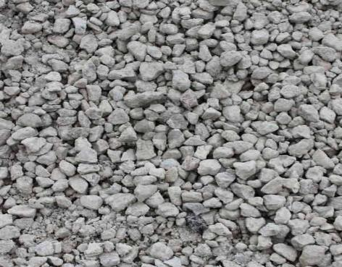
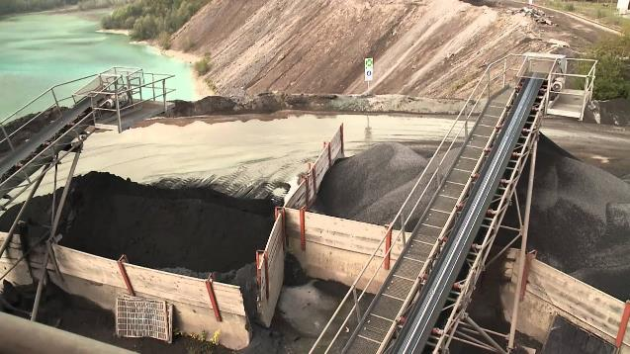
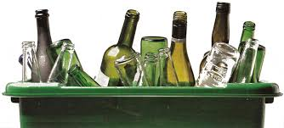
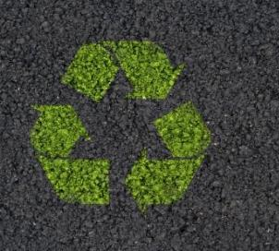
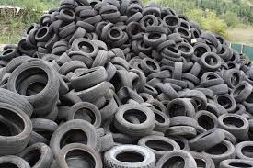
Recycled Materials Currently Used
Notes:
Crushed concrete
Fly ash
Recycled glass
RAP
Crumb rubber
Industrial slag

Slide 9
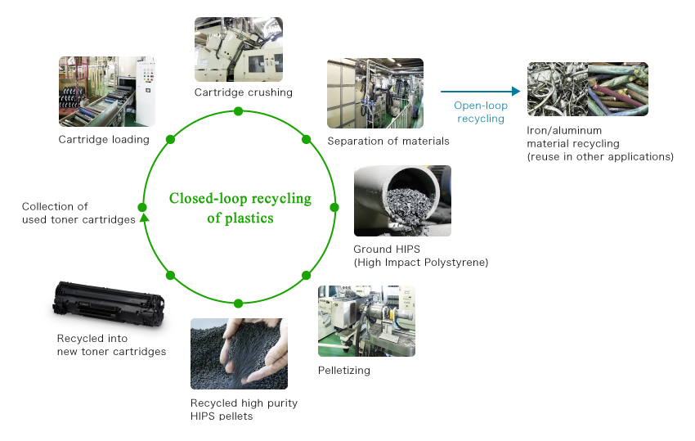
Toner
Canon cartridges recycling program
Notes:
Another recycled material that I am covering is toner cartridges
Printer cartridges are made up of a complex mix of plastics, metal, inks and toners (polymers) and thus represent a significant investment in resources
A large amount of toner from photocopiers and printers is produced every year.

Slide 10
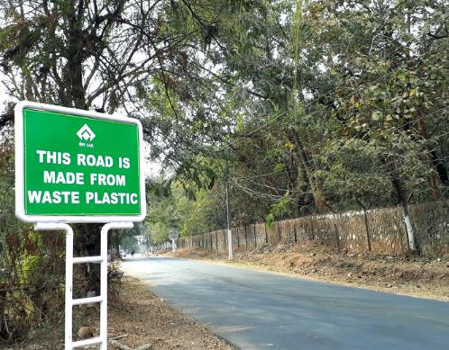
Recycled Plastics on Our Roads
The approach is similar to the use of PMBs
Incorporate the recycled material into asphalt to enhance performance
Two ways of mixing
wet
dry
The role of recycled plastics as a:
binder extender
aggregate extender
asphalt extender
Notes:
The approach is similar to the use of PMBs. Which is incorporate the polymer into asphalt mixture as an enhancer.
There are two ways of mixing – wet and dry.
Wet – the modifier is added to the binder prior to mixing with aggregate
Dry – modifier are added directly to hot aggregate prior to the addition of binder
Recycled plastics can act as …

Slide 11
Waste
Plastics
Notes:
A bit of background on waste plastics or recycled plastics
There are 7 categories – each has different properties which makes it suitable for different applications
The most commonly recycled plastics in Australia are PET, HDPE, LDPE and PP
Next – I will be showing you a summary of the various literature demonstrating the performance of recycled plastics.

Slide 12
 | Binder extender | Asphalt extender | Aggregate extender
Findings | Lower pen @ 25deg, higher SP, RV and ER Higher SP , lower pen, better digestion | (3) Improves properties significantly (4) Higher temperature susceptibility, low temp anti-cracking, improved rutting and fatigue resistance | Reduce extraction of natural product
Challenges | Smaller temperature susceptibility Not all improve properties | (3) Lack of elastic recovery (4) Only looked into PEs | Weakened bonds
Comments | HDPE, LDPE better performer | (3) Need some form of elastomeric polymer (4) < 6% addition of plastics | Introduce oxidizing agent
Notes:
Binder:
Lab study to compare the effect of various percentages of PE from silo bags added to a bituminous mixture and to two other mixtures containing bitumen and PMBs
Lab study to evaluate the benefits of modifying bitumen with different plastic waste. The selected plastics were EVA, HDPE, LDPE, SBS and ABS
Asphalt:
Numerous studies have investigated the use of recycled plastics in asphalt mixes. General consensus is it shows improved properties
One of the study used a pavement simulation model to predict rutting on an asphalt surface over a period of 20 years. The result was positive. 17 years without the need for maintenance.

Slide 13
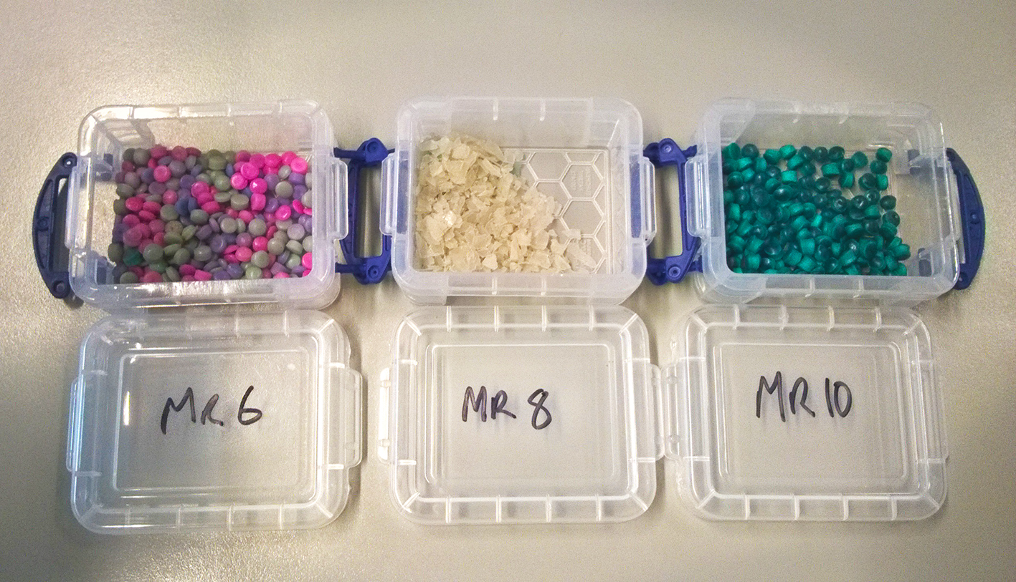
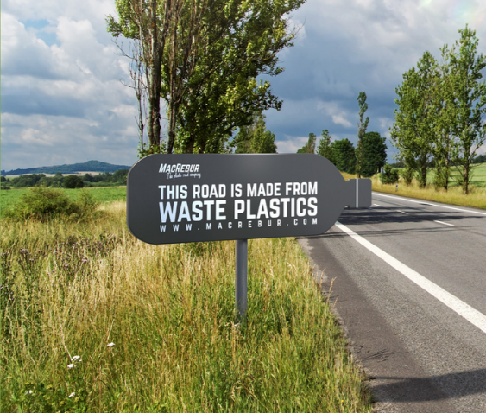
4. Case Studies – Australian Experience
MacRebur
2018 - Brisbane City Council
Limited info
Notes:
Scottish product
3 products:
MR6-pellet form. Intended to be incorporated directly into the asphalt production plant. Reported to work well in hot conditions (like in Aus) as it has a higher melting point
MR8 – shredded plastics – designed to be more economical bitumen extender without any performance enhancement
MR10- pellet form – provide more crack resistant binder. It works better in colder climate such as UK, Canada and Russia
Video

Slide 14
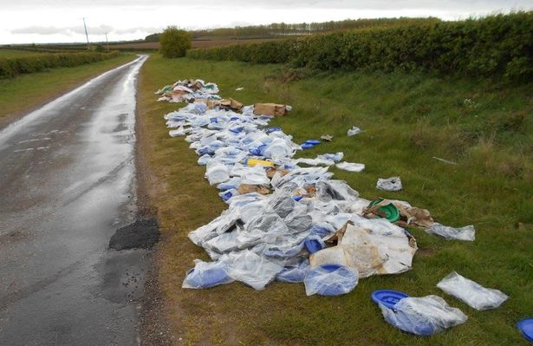
Case Studies – Australian Experience
Downer Group – Reconophalt
Every 1km of 2 lane way road:
530,000 plastic bags
168,000 glass bottles
12,500 waste toners
REDcycle/ Close the Loop – collects plastic bags from supermarkets
Notes:
The use of soft plastics into roads
First trial was done in Craigieburn, city of Hume
Use of soft plastics and glass and RAP and toner cartridges
As a value added application
Mimic a standard Vicroads asphalt
Reported 65% improvement in fatigue life
think about the whole of life cost terms – potential reduction in maintenance cost being improved
Further to the Melbourne trial, Reconophalt has been on a tour around Australia covering Queensland, NSW, SA, Tasmania

Slide 15
Reconophalt

Slide 17
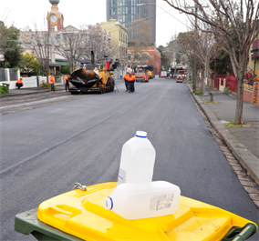
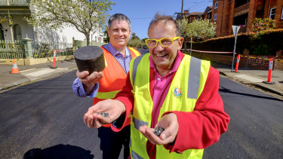
Case Studies – Australian Experience
Alex Fraser - PolyPave
City of Yarra
Fulton Hogan - PlastiPhalt®
2018 - City of Port Philip
2019 - City of Port Adelaide
Plastic bags and 20% RAP

Slide 18
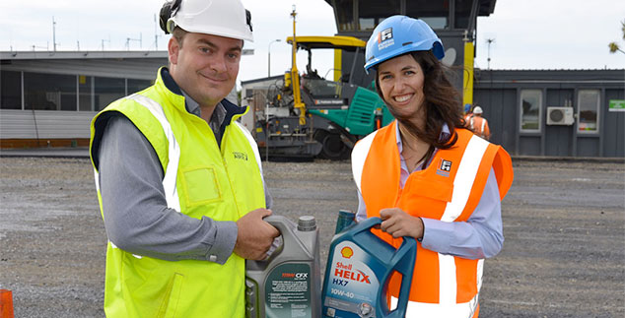
Case Studies – New Zealand Experience
Fulton Hogan - PlastiPhalt®
Used oil containers
Christchurch airport

Slide 19
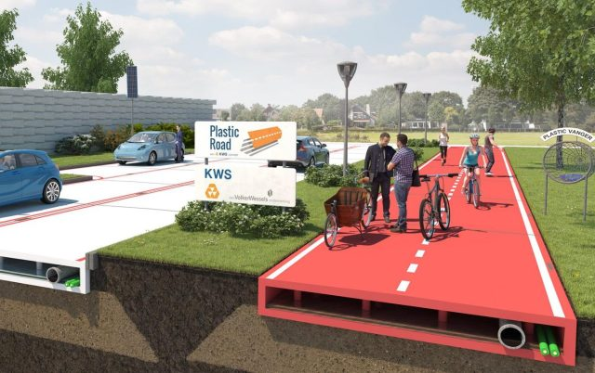
Case Studies – Overseas Experience
Netherlands - Zwolle
PlasticRoad
30m long bike path
70% recycled plastics: old plastic bottles, beer cups, cosmetic packaging, plastic furniture
last 3 times longer
Notes:
Clever road design
It uses prefabricated and lightweight modular just like lego.
Therefore, installation is fast and reduces traffic downtime and traffic obstruction often caused by the traditional road construction methods
This method also cuts down on ghg emissions
Another interesting feature is in its hollow design. It creates space for all kinds of utility services like pipelines and cables for high speed internet, storing rainwater to prevent floods.
It was reported that this concept offers opportunities for further innovation such as solar heated roads, light poles, and traffic loop sensors

Slide 20
Case Studies – Overseas Experience
Canada – City of Vancouver
Converting 100% plastics into wax which is compatible with WMA and high RAP content
The City had a set of criteria when considering new technology:
no additional infrastructure required to produce WMA
no major change to operations during trial
current mix designs are used
use of RAP continues
re-recyclability of asphalt would continue
cost effective

Slide 21
Case Studies – Overseas Experience
India
First built in 2002
Technology by Prof Vasudevan
Mix shredded plastic to hot bitumen and aggregate
Mainly used on rural and lightly loaded roads
2015, mandatory to use waste plastic on urban roads

Slide 22
5. Benefits of using recycled plastics
Reduced landfill
Reduced reliance on virgin non-renewable resources
Improved road building material options
It is a consistent and reliable source of recycled materials
Improved sustainability
Climate and infrastructure resilience benefits

Slide 23
6. Areas of Concern
OH&S – possibility of highly toxic emissions, fuming, toxic elements remain in environment and build up in food chain
Microplastics – breaking down into tiny particles, threat to marine life
Re-recyclability – no studies done to date
Storage stability – storage at high temperature could affect properties
Materials lifecycle sustainability – use of ISCA Materials calculator
Notes:
There are major concerns about the occupational health and safety hazards
Microplastics – break down into tiny particles. If the recycled plastics used on our pavement are broken down into tiny particles and flushed down watercourses into rivers/ waterways, will pose major threat to our marine life
Lifecycle sustainability – more and more road agencies are registering their projects for infrastructure sustainability ratings with Infrastructure Council of Aus (ISCA)
In assessing the recycled plastic road products, there is a need to consider:
Source
How is it intended to be used
Potential environmental risks
End of life considerations

Slide 24
7. Governance Framework
The need to address sustainability issues while maintaining pavement performance
Use of recycled plastics on roads in Australia is still new
Concerns over the incorporation of ‘other’ additives
EAPA position statement on waste in asphalt
Waste legislation is ill-defined and complex
Benefits of recycling with respect to hazard classification and risk assessment is unknown
One of the common hurdles (AU, NZ, EU) is the lack of confidence in the quality of recycled materials
There is a need for an Australian framework
Adoption of Environmental Product Declarations (EPD)
Notes:
To address issues of sustainability while maintaining pavement performance
These concerns have been echoed in the EAPA position statement
European asphalt pavement association (EAPA) – AAPA equivalent
Australia could really learn from our counterparts in Europe by collaboratively expressing our position in this space
Some of the recommendations made in the EAPA:
RAP should be given priority because of the energy savings
Producers need to show proof that they have gone through stringent risk assessment on WHS and environmental impacts

Slide 25
Specification
Performance based and prescriptive approach
Desired performance level but does not make demands on how it is achieved
Encourages flexibility in innovation
Performance based airport asphalt specification (AAPA, 2018)
warranty schedules
tender schedules
risk and maintenance pricing ….
Risk allocation – producers main risk bearers
principles and warranties to be considered
Notes:
- Performance based specs describes the results required and leave it to producers to satisfy that requirement
Encourages innovation
AAPA report – provides some non technical issues that the council can consider such as warranty schedule, tender schedules, risk and maintenance pricing, etc.

Slide 26
8. Recommendations
Governing framework
Independent review
Long term economic benefit
Lifecycle sustainability assessment
The use of HDPE and LDPE
Performance and prescriptive based specification
Road trials
Sprayed sealing research
Monitoring complimentary projects
Notes:
This list was recommended to Austroads as future guidance on their R&D priority on the use of recycled plastics on road

Slide 28
Christina Chin – 0452 490 880
christinac@level5design.com.au

Slide 29
https://www.youtube.com/watch?v=cHWYoDKYnQo

